Slide 1

IMPROVING THE TAKAFUL SECTOR IN ISLAMIC COUNTRIES
AlHuda-CIBE 2nd International Conference on Islamic Leasing (Ijarah) and Takaful | Assoc. Prof. Dr. Yusuf Dinç Istanbul Sabahattin Zaim University Islamic Economics and Finance Department Director of Management, Entrepreneurship and Leadership Research Center

Slide 2


COMCEC REPORT

Slide 3
ObjectIves of the REPORT
Providing an analysis of the theoretical and legal nature of Takaful, including the interpretation of various scholars on the comparison of conventional and Islamic insurance.
Giving detailed analysis on the current size and trends, structures, modes, and instruments of Takaful.
Explaining the operational aspects of Takaful business, including a comprehensive and detailed analysis on types of Takaful structures, legal, regulatory and technical challenges facing Takaful sector.
Doing country analysis on the selected countries on Takaful market.

Slide 4

CONCEPTUAL FRAMEWORK OF TAKAFUL
AAOIFI:
Takaful is “a process of agreement among a group of persons to handle the injuries resulting from specific risks to which all of them are vulnerable”.
BNM:
Takaful is “an arrangement based on mutual assistance under which Takaful participants agree to contribute to a common fund providing for mutual financial benefits payable to the Takaful participants or their beneficiaries on the occurrence of pre-agreed events” .
IFSB:
Takaful is "a mutual guarantee in return for the commitment to donate an amount in the form of a specified contribution to the participants’ risk fund, whereby a group of participants agree among themselves to support one another jointly for the losses arising from specified risks”.

Slide 5
SIgnIfIcance of Takaful
The rapid development of Islamic finance has necessitated the need for Shari'ah-compliant alternative to conventional. This alternative, which is based on Shari'ah principles may also be referred to as “Islamic insurance”.
Takaful operates in line with Shari'ah principles and, at the same time, offers the benefits and services equivalent to its conventional counterpart. Therefore, Takaful has evolved in response to the ever-increasing yearning of faith-based financial consumers for an insurance system fulfils their religious beliefs and provides the desired risk coverage for individuals and IFIs. (corporations)
The industry has rapidly developed in such a short period globally in both Muslim and non-Muslim countries. This growth has far-reaching positive implications for individuals and businesses patronizing Takaful and abandoning conventional insurance for reasons related to both business and belief.

Slide 6
The maIn features of Takaful
The main features of Takaful can be summarized as follows:
  Policyholders (Takaful participants) jointly protect their common interest.
  The participants pay their contributions to assist those of them who need assistance.
  The payment of Takaful contributions is made based on tabarru’ to share the burden of losses and spread liability as per the community pooling system.
  Based on the contract of tabarru’, the element of uncertainty in the payment of contribution and compensation is tolerated.
  Takaful is not aimed at taking the advantage at the cost of others.
  The Takaful company is not an insurer which is obliged to pay indemnification or Takaful benefits to the participants, but it is only a manager or administrator responsible for managing the fund and administering its operations.

Slide 7
OvervIew of IslamIc fInance Industry
The Islamic finance industry is made up of three sections: Islamic banking, Islamic capital markets and Islamic insurance or Takaful. Among other segments of Islamic finance, Islamic insurance, which is called Takaful is the objective of this report. Being one of the major constituents of the modern Islamic finance industry, the theory and practice of Takaful are based on fundamental principles of Islamic finance.
Since the emergence of the modern Islamic finance industry in the 1960s, there has been a continued and accelerated development of Islamic finance, which has been gathering momentum with specific regional and global developments during the past five decades.
Nevertheless, Takaful has not achieved a similar achievement in its own unique segment, as it continues to struggle to expand its frontiers within the Muslim world and to gain a considerable market share in a world dominated by conventional insurance. This makes a case for the need to improve the Takaful sector in Muslim jurisdictions across the world – an objective this study that seeks to achieve in a comprehensive manner.

Slide 8
THE TAKAFUL GLOBAL LANDSCAPE
According to the IFSB report (2020), the total Takāful contributions grew by 3.2% in 2018 to reach USD 27.07 billion; a slower growth rate than the 4.3% reported in 2017.
By region, the GCC region led with contributions estimated at USD 11.70 billion, accounting for 43.2% of the total global contributions. The MESA region is next with a 42.0% contribution (USD 11.36 billion), followed by South- East Asia (USD 3.02 billion) and Africa (USD 0.55 billion), representing 11.2% and 2.03%, respectively
The largest share of the Takaful contribution was captured by the general Takaful sector (82.6%), and family Takaful was the rest (17.4%). The ratios of general and family Takaful regarding regions in 2019 were as follows: GCC (94.7/5.3)%, MESA (86/14)%, SEA (71.7/28.3)%, and Africa (84.8/15.2)%.
The key regions have the following Takaful operators based on the numbers such as MESA (114), SEA (106), GCC (79), and Africa (54). Among these operators, 222 are full-fledged takaful operators, 88 takaful windows, 28 re-Takaful windows, and 15 full-fledged re-Takaful operators.

Slide 9
SWOT Analysis
Use of Technology to Sustain the Quality of Services
Successful Product Development and Innovation
High Level of Customer Satisfaction
Well-developed Distribution Networks
Strong Free Cash Flow for Further Expansion of Projects
High Rate of Return on Shari'ah-compliant Investments
Having High-Skilled Workforce
Diversification Across Countries
High Attrition Rate in Workforce
Lack of Efficient Financial Planning
Rigid Organization Structure to Accommodate New Business Models
Poor Marketing Strategies
Lack of Investment into Research and Development (R&D) - Below Industry Average
Internal Factors
STRENGTHS
WEAKNESSES
Strong Support from the Government for Development of the Industry
New Customers via Online Channels
Access to New Insurance Technology
Future Growth due to Political and Economic Stability
Expansion in Other Countries
Intense Competition from Takaful Operators and Conventional Insurers
New Restrictive Regulations
Irregular Development and Supply of New Products
Vulnerable Cybersecurity
High Bureaucracy Level as an Impediment to Growth
OPPORTUNITIES
THREATS
External Factors

Slide 10
Challenges Facing the Takaful Industry
Political & Macro Environment
Regulatory Framework
Business Operations
Technology
Political Uncertainty
Macro Conditions
Market Confidence
Legislation
Transparency & Disclosure
Market Confidence
Capital Requirement & Solvency Margin
Business Models
Quality of Operations
Product Development & Innovation
FinTech/ InsurTech
Cybersecurity

Slide 11
Challenges Facing the Takaful Industry
Shari’ah Framework
Infrastructure
Market
Human Capital
Shari’ah Governance
Shari’ah Standards
Shari’ah Board
Shari’ah Audit
Distribution Channels
Availability of Re-Takaful Services
Availability of Shari’ah-compliant Instruments for Investment
Competition with Takaful Operators
Competition with Insurers
Weak Customer Base
Low Consumer Awareness
Business Models
Quality of Operations
Product Development & Innovation

Slide 12
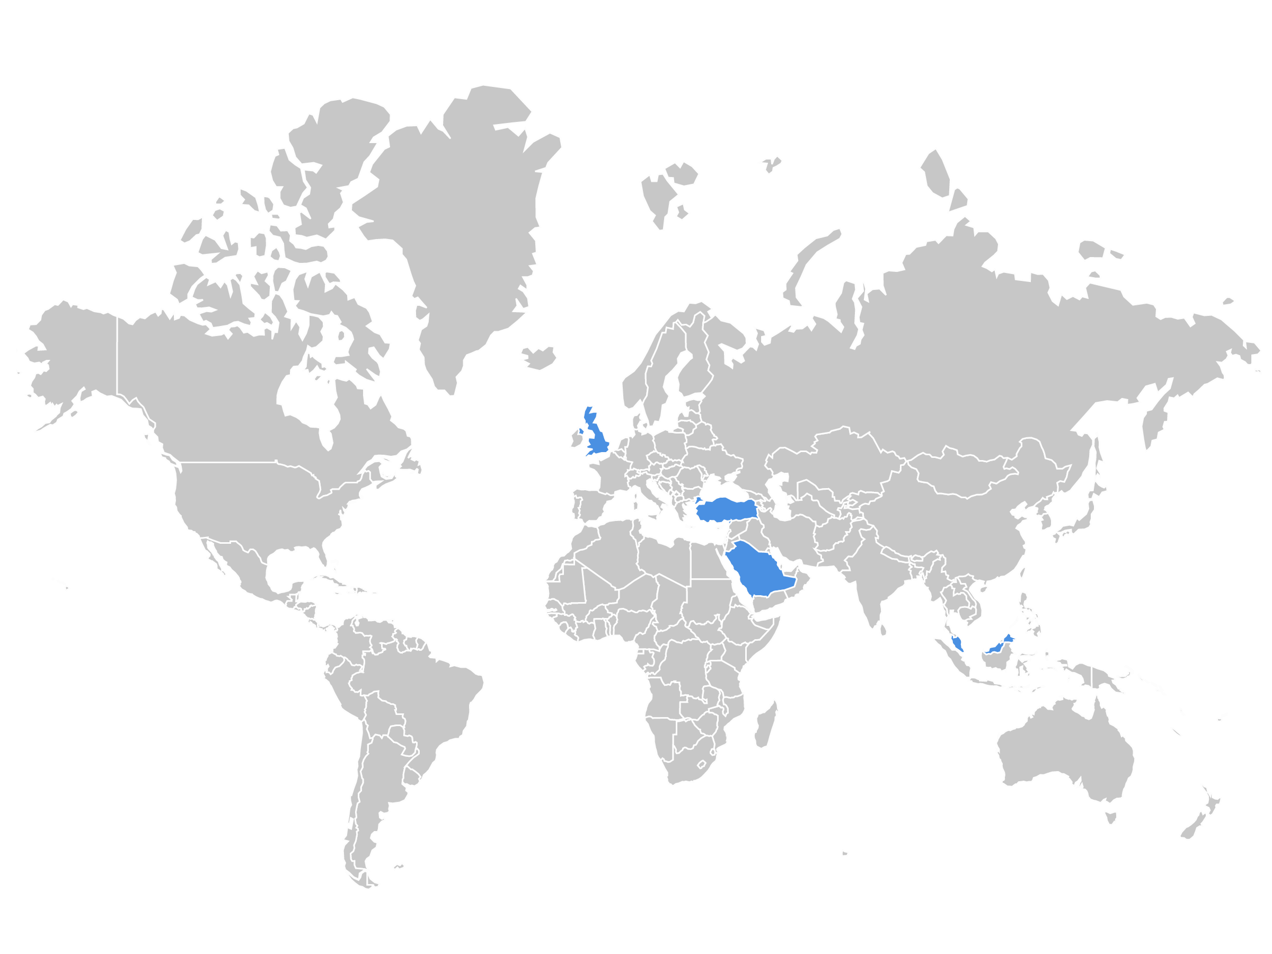
The UK
Sample Countries:
Turkey
3 OIC member countries
Malaysia: Dual System
Saudi Arabia: Full-Fledged
Turkey: Consolidated
Saudi Arabia
Malaysia
1 Non-OIC member country
- The United Kingdom

Slide 13
AnalysIs of Survey Results
* Includes the financial analysts, bankers, actuarial experts, and postgraduate PhD students.
**The total number of responses was 218, out of which 166 only are complete. Source: Authors

Slide 14
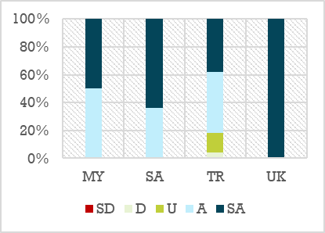
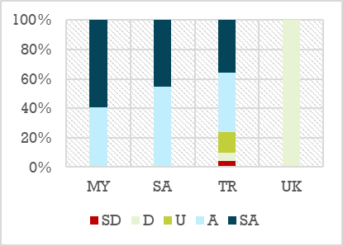
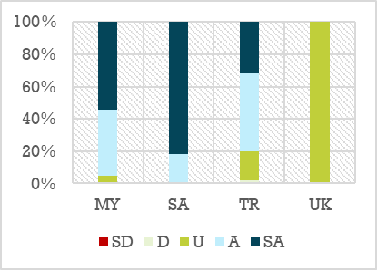
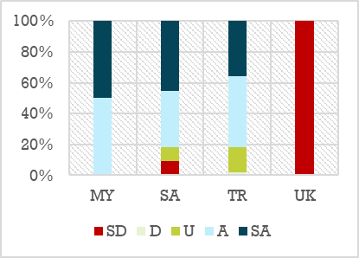
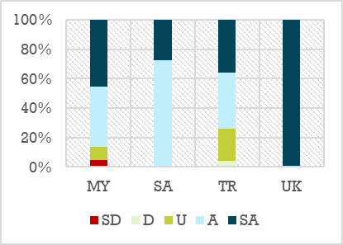
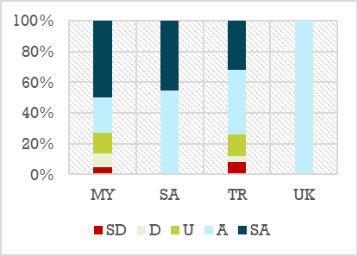
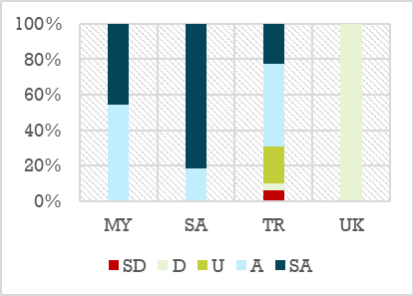
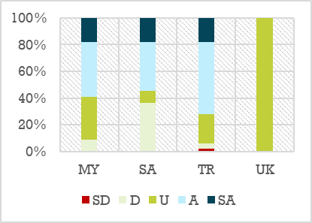
STRENGTHS
(A) Use of Technology to Sustain the Quality of Services | (B) Successful Product Development and Innovation | (C) High Level of Customer Satisfaction | (D) Well-developed Distribution Networks
(E) Strong Free Cash Flow for Further Expansion of Projects | (F) High Rate of Return on Shari'ah-compliant Investments | (G) Having High-Skilled Workforce | (H) Diversification Across Countries

Slide 15
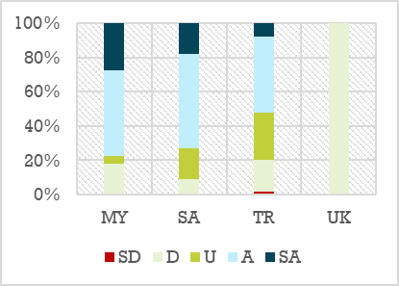
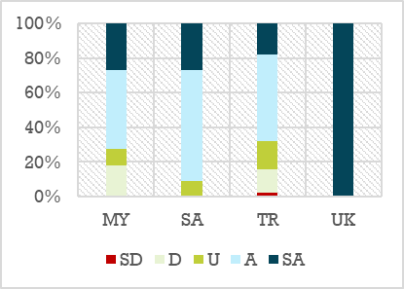
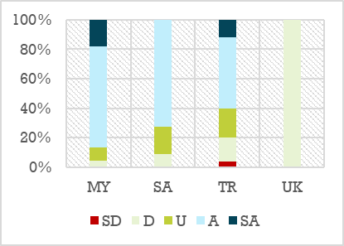
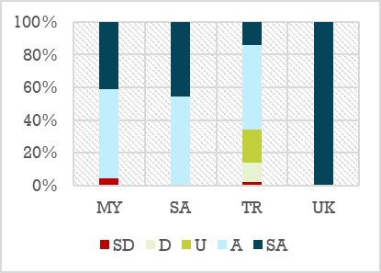
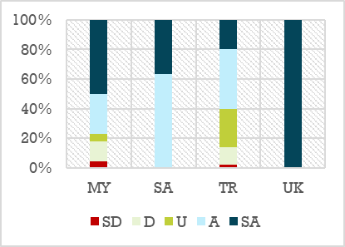
WEAKNESSES
(A) High Attrition Rate in Workforce | (B) Lack of Efficient Financial Planning | (C) Rigid Organization Structure to Accommodate New Business Models
(D) Poor Marketing Strategies | (E) Lack of Investment into Research and Development (R&D) - Below Industry Average

Slide 16
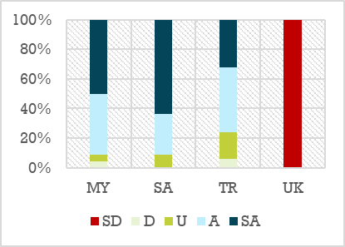
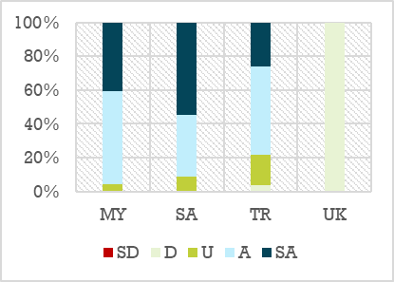
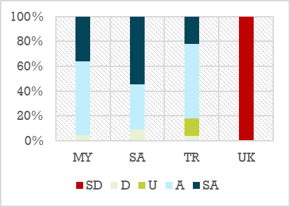
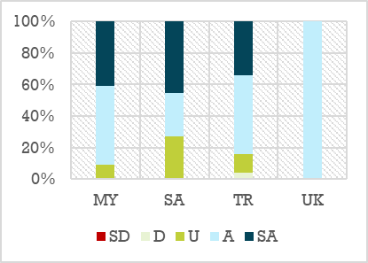
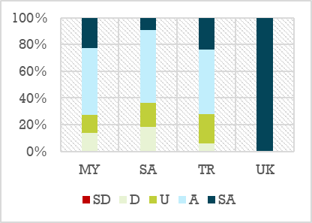
OPPORTUNITIES
(A) Strong Support from the Government for Development of the Industry | (B) New Customers via Online Channels | (C) Access to New Insurance Technology
(D) Future Growth due to Political and Economic Stability | (E) Expansion in Other Countries

Slide 17
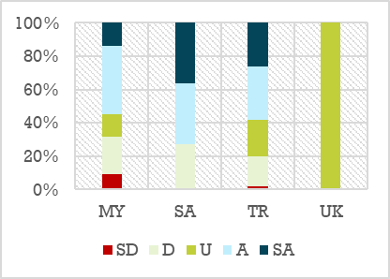
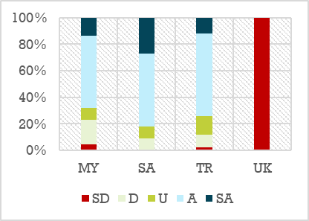
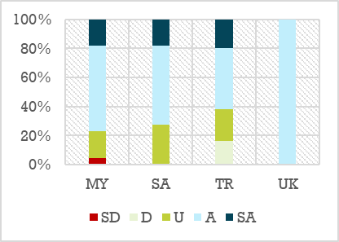
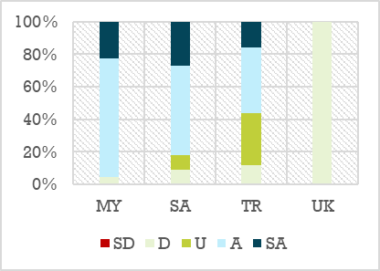
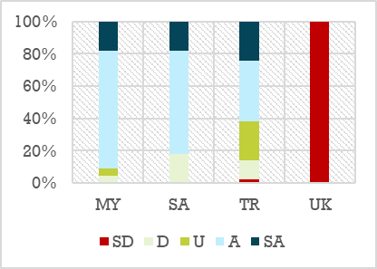
THREATS
(A) Intense Competition from Takaful Operators and Conventional Insurers | (B) New Restrictive Regulations | (C) Irregular Development and Supply of New Products
(D) Vulnerable Cybersecurity | (E) High Bureaucracy Level as an Impediment to Growth

Slide 18
Legal and Regulatory Framework

Slide 19
SharI’Ah Framework

Slide 20
Products and ServIces

Slide 21
Talent Development

Slide 22
Takaful BusIness SustaInabIlIty

Slide 23
CONCLUSION And Recommendation
I. For New and Emerging Takaful markets
Set up the supportive regulatory and legal frameworks
Increase the awareness of the market about the nature of Takaful
Develop the Shari’ah framework
Develop a comprehensive Islamic finance
Build a human capacity
II. For Developed Takaful markets
Embrace new technology and maintain cybersecurity
Ensure the continuous human capital development
Stimulate innovation

Slide 24
Future
There is a recurring concern, which consists of the absence of strategic investment in human capital and professional development, as pointed out by practitioners and policymakers.
Takaful organizations need to realize the need to address the regulatory compliance, consumer protection and good governance practices to facilitate well-balanced strategies for growth and sustainability.
In this digital age, Takaful players need to proactively reap the technology advancement to become relevant in the market by investing and deploying new technological solutions; otherwise, the Takaful industry would become inefficient and obsolete.
The Takaful Operators need to ensure that their scheme is more transparent, being different from insurance. Takaful must prove that its image of being an imitator is not right and that it is not following or imitating conventional insurance.

Slide 25
Reference
AAOIFI (2014). Al-Ma’ayir al-Shar’iyyah (Shari'ah Standards). Accounting and Auditing Organization for Islamic Financial Institutions, Manama, Bahrain.
Al-Qalqeeli, A. (1961), Aqd al-Ta’min (The Contract of Insurance), Ibn Taymiyyah Festival, Damascus, Syria.
Belouafi, A. and Chachi, A. (2014) Islamic Finance in the United Kingdom: Factors Behind its Development and Growth, Islamic Economic Studies, Vol. 22, No. 1, May 2014 (37-78) DOI No. 10.12816/0004130
Benbouzid, R.F. (2005). The Success of Re-Takaful – Arab Insurance, Outlook and Actual New Economic Situation. Available at: https://studylib.net/doc/15103583/the-success-of-Re-Takaful-arab-insurance--outlook-and-actu. Access date: 10/07/2019.
Bhatty, A. (2010). The growing importance of Takaful insurance. In Asian Regional Seminar (pp. 23–24). Kuala Lumpur, Malaysia: Asia Regional Seminar organized by OECD and Bank Negara Malaysia under the sponsorship of the Government of Japan.
BNM (2004). Malaysian Takaful Industry 1984-2004. Bank Negara Malaysia. Retrıeved from: https://www.bnm.gov.my/files/publication/tkf/en/2004/booklet.en.pdf. Access date: 29/08/2019
Colón, J. C. (2011). Choice of Law and Islamic Finance. Texas International Law Journal, 46, 411–435.
COMCEC (2016, April). Developing Islamic Finance strategies in the OIC member countries. COMCEC Coordination Office.
Dahnoun, M., & Alqudwa, B. (2018). Islamic Insurance: An Alternative to Conventional Insurance. American Journal of Humanities & Islamic Studies. Vol, 1, 1.
D'Alvia, D. (2017). (Legal) Uncertainty: Takaful Between English Common Law and Shari'ah Law. International Review of Law, 2017(1), 10.

Slide 26
Cont.
Hassan, A., & Mollah, S. (2018). Operational Mechanism of Takaful and Re-Takaful. In: Islamic Finance (pp. 193-205). Palgrave Macmillan, Cham. https://doi.org/10.1007/978-3-319-91295-0_14
Hassan, M. K., Kayed, R. N., & Oseni, U. A. (2013). Introduction to Islamic Banking and Finance: Principles and Practice. United Kingdom: Pearson.
IFSB (2013). Risk Management for Takaful Undertakings. Islamic Financial Services Board. Kuala Lumpur, Malaysia.
Maysami, R. C., & Williams, J. J. (2006). Evidence On the Relationship Between Takaful Insurance and Fundamental Perception of Islamic Principles. Applied Financial Economics Letters, 2(4), 229–232.
OIC Fiqh Academy (2016, June). Resolution of OIC Fiqh Academy No.200 (6/21). Islamic Economic Studies, 24(1), 117-127. Available at: http://www.irti.org/English/Research/Documents/IES/197.pdf
SAMA (2019a). Licensed Companies. Saudi Arabian Monetary Authority. Retrieved from: http://www.sama.gov.sa/en-US/Insurance/Pages/Licensed_Companies.aspx. Access date: 29/08/2019
World Trade Organization (2003, July). Cooperative Insurance Companies Control Law. World Trade Organization. Royal Decree No M/32. Retrieved from: http://tiny.cc/q01zbz. Access date: 30/08/2019
Zuhayli, W. (1997). Al-fiqh al-Islami wa Adallatuh (Islamic Jurisprudence and its Justice). Damascus: Dar al-Fikr. Available at: http://shamela.ws/index.php/book/384

Slide 27


Thanks…

